Slide 1





DEAF ASSISTANT
YOUR FRIENDLY DEAF ASSISTANT
Supervised By
Prof. Dr. Hussam Elbehiery
T.A. Andrew Nader

Slide 2
AGENDA
Introduction & Problem Statement
Previous Work & Objectives
Solution Overview & Key Features
Technology & System Architecture
Impact & Significance
Conclusion & Future Work

Slide 3
PROBLEM STATEMENT
1
2
3
Communication barriers exist between Arabic-speaking deaf individuals and hearing individuals.
Lack of technology supporting Egyptian Arabic Sign Language (EASL).
Daily challenges in education, healthcare, and public services.

Slide 4

PREVIOUS WORK

Slide 5
PREVIOUS WORK
BelYadien
Deaf Assist
A Previous project, “BelYadien,” served as a base and structure for our project “Deaf Assist”, where Arabic sign language translation was performed based on the letter-by-letter translation of words. Each letter was presented through a GIF, collectively forming a word using individual letters
Our project, “Deaf Assist,” builds on the structure of “BelYadien” but shifts to a word-by-word translation approach. Rather than spelling out words letter by letter, it recognizes full signs that represent complete words in Arabic sign language. This method improves translation speed and makes communication more natural and efficient.

Slide 6
OBJECTIVES
Mobile Application
The Deaf Community
Develop a mobile app that translates EASL into Arabic text and speech in real-time.
Promote inclusivity and independence for the deaf community.

Slide 7
BACKGROUND & MOTIVATION
Why This Project?
Our Impact
Over 70 million deaf people worldwide, with limited tools for Arabic-speaking regions.
Empowering the deaf community to communicate effectively in daily life, education, and work.

Slide 8

KEY FEATURES
Arabic Sign Language Support
Real-Time Translation
Platform Compatibility
user-friendly interface

Slide 9
TECHNOLOGY STACK
AI & ML Models
Backend
Mobile Development
AI Integration
Convolutional Neural Networks (CNNs) for gesture recognition.
Natural Language Processing (NLP) for text mapping.
Text-to-Speech (TTS) for Arabic audio output.
ASP.NET Core 9, RESTful API
Microsoft SQL Server.
Flutter for cross-platform compatibility.
ONNX Runtime for efficient model deployment.

Slide 10



SYSTEM ARCHITECTURE
Frontend
01
Mobile app (Flutter) captures gestures and displays translations.
Backend
02
API processes videos, AI model recognizes gestures, and database stores translations.
AI Model
03
CNN-LSTM hybrid model for dynamic gesture recognition.

Slide 11
OUR ALGORITHMIC JOURNEY

Slide 12
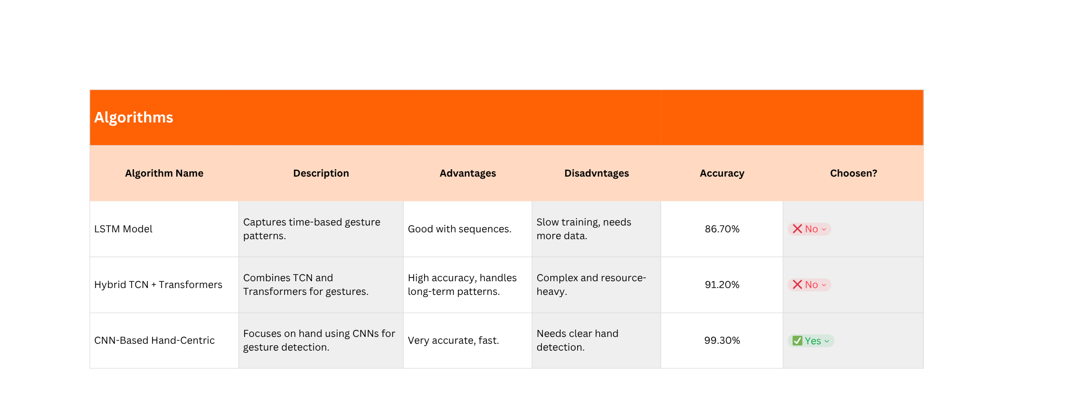
OUR ALGORITHMIC JOURNEY
After careful consideration, we chose algorithm CNN-Based Hand-Centric for further processing with our model.

Slide 13
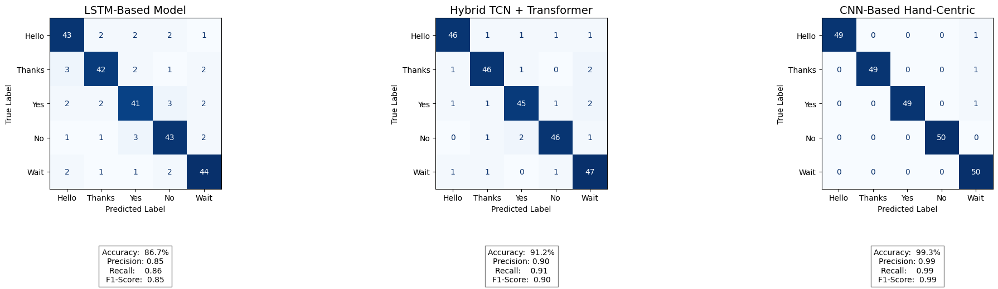
CONFUSION MATRICES

Slide 14
DESIGN

Slide 15
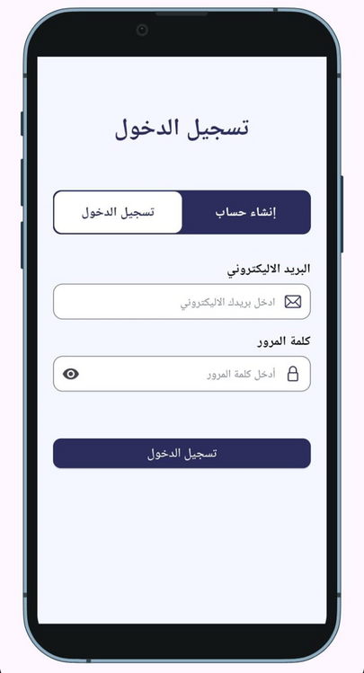
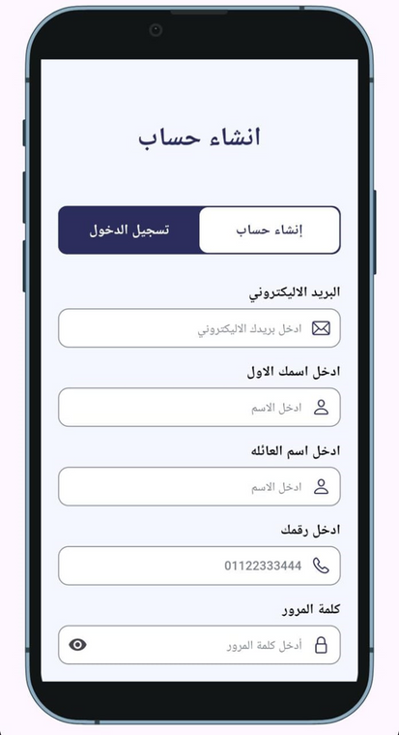
AUTHENTICATION
LOGIN
REGISTRATION

Slide 16
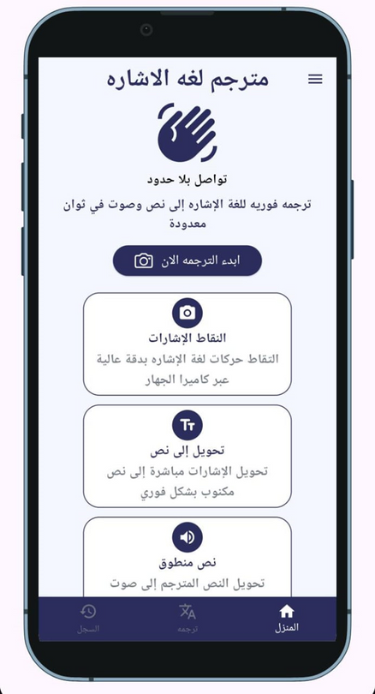
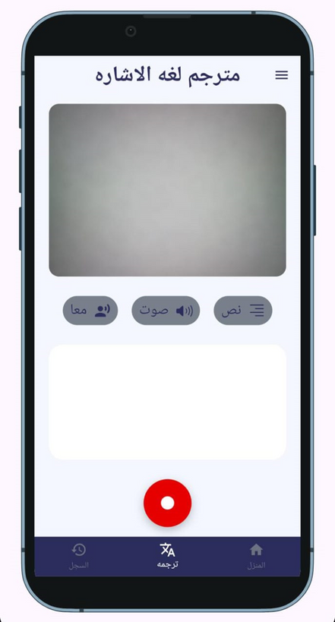
MAIN FEATURES
TRANSLATE SCREEN
HOME SCREEN

Slide 17
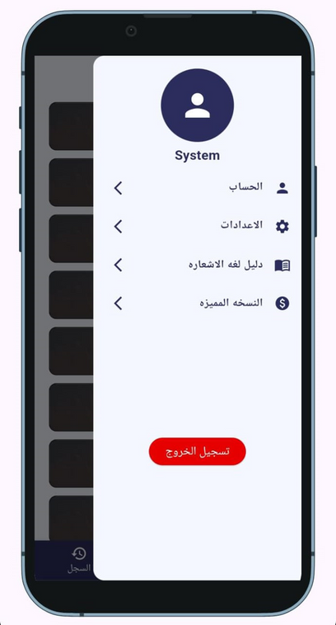
DRAWER SCREEN
APP DRAWER

Slide 18
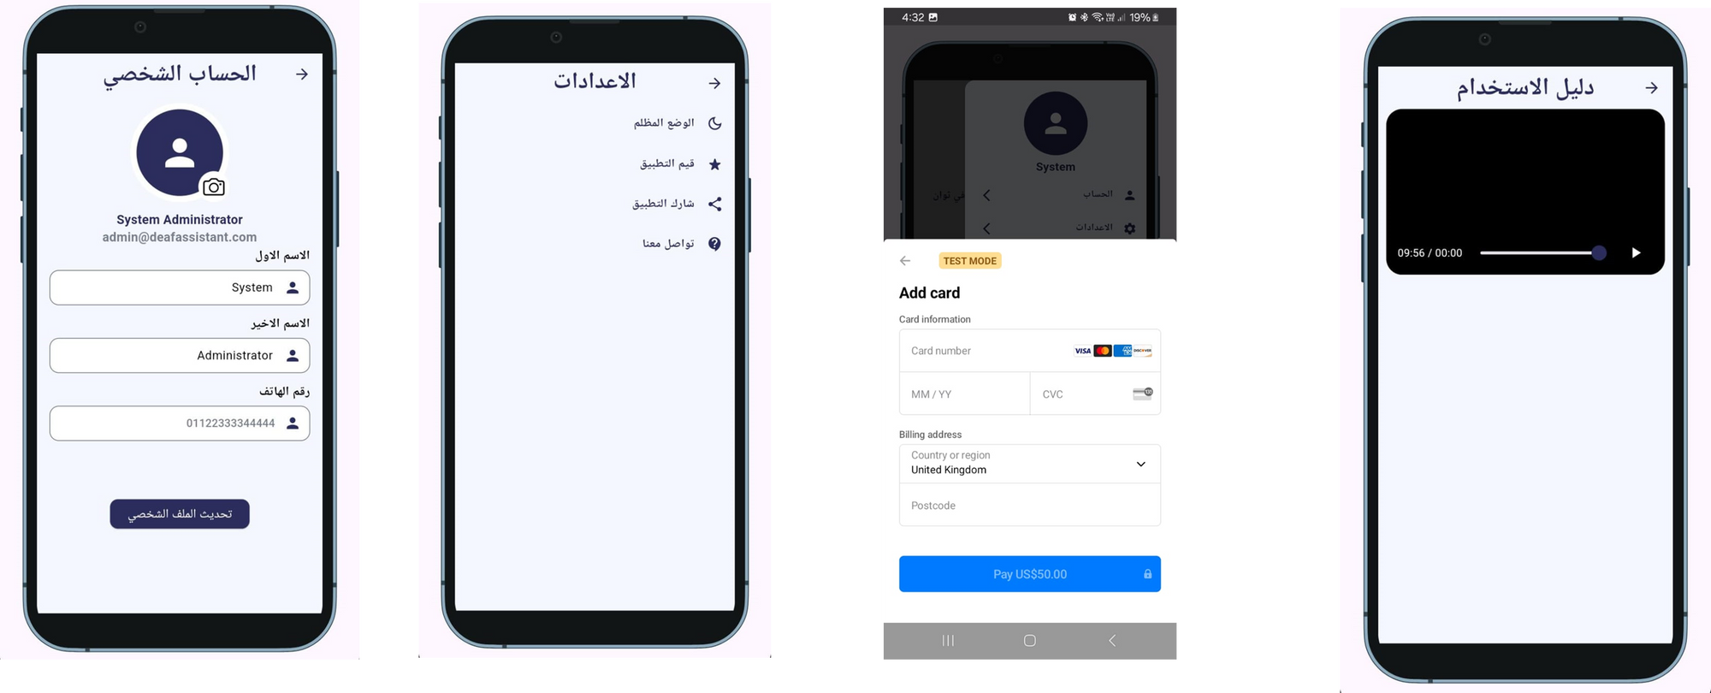
DRAWER FEATURES PT.2
PAYMENT GATEWAY
PROFILE EDIT
SETTINGS
USER GUIDE

Slide 19

CHALLENGES AND SOLUTINS

Slide 20


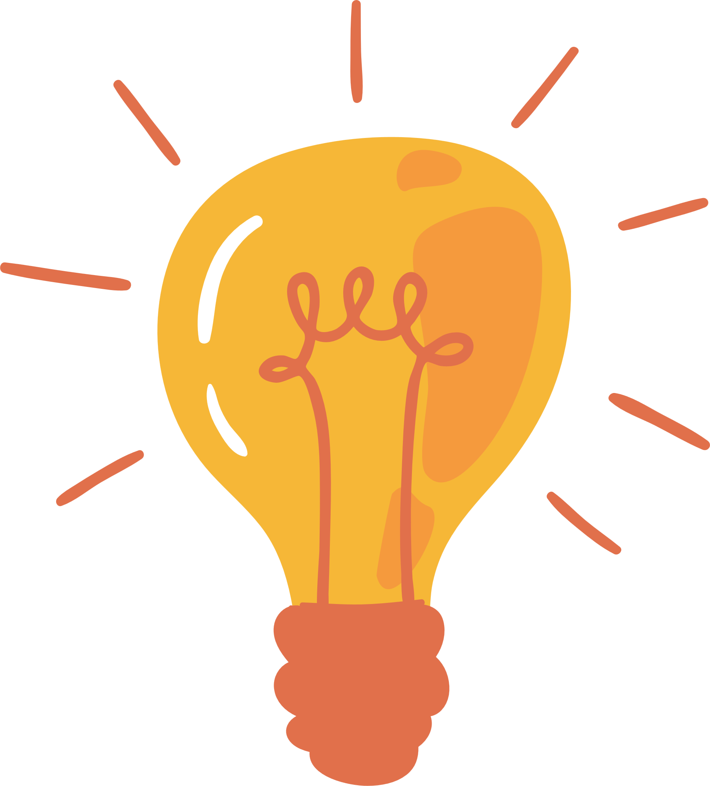
CHALLENGES AND SOLUTINS
Challenges
Solutions
Limited dataset for EASL.
Real-time performance on mobile devices.
Cultural and linguistic nuances in Arabic Sign Language.
Iterative dataset expansion through user feedback.
Optimized AI models for low-latency performance.
Collaboration with linguistic experts for cultural relevance.

Slide 21

IMPACT AND SIGNICANCE
Impact And Significance
Empowering the Deaf Community
Real-time translation reduces reliance on interpreters.
Bridging the Communication Gap
Enables seamless interaction between deaf and hearing individuals.
Advancing Accessibility Technologies
Sets a benchmark for future AI-driven assistive tools in Arabic-speaking regions.

Slide 22
IN CONCLUSION...
The Deaf Assistant app is a groundbreaking solution for the Arabic-speaking deaf community, leveraging AI and ML to break communication barriers.
Encourage adoption of the app and further research in assistive technologies for underserved communities.

Slide 23
FUTURE WORK

Slide 24




FUTURE WORK
Expand Language Support
Enhance AI Model
Include other regional Arabic sign languages (e.g., Levantine, Gulf).
Improve accuracy for complex gestures and sentences.
Gamification
Integration with Wearables
Add interactive learning modules to encourage sign language education.
Explore integration with smart glasses or AR devices for hands-free translation.

Slide 25
THANK YOU!

Slide 26
DIAGRAMS

Slide 27
DATA FLOW DIAGRAM:
LEVEL 0 & LEVEL 1
Level 0: System Overview
Level 1: Detailed Interactions
Illustrates the flow of data between key system components.
Expands on user actions and backend processes.
Includes login, translation, payment processing, and history retrieval.
Inputs: Video capture from users.
Outputs: Translated text or speech.
Components: API, AI Model, Payment System.

Slide 28
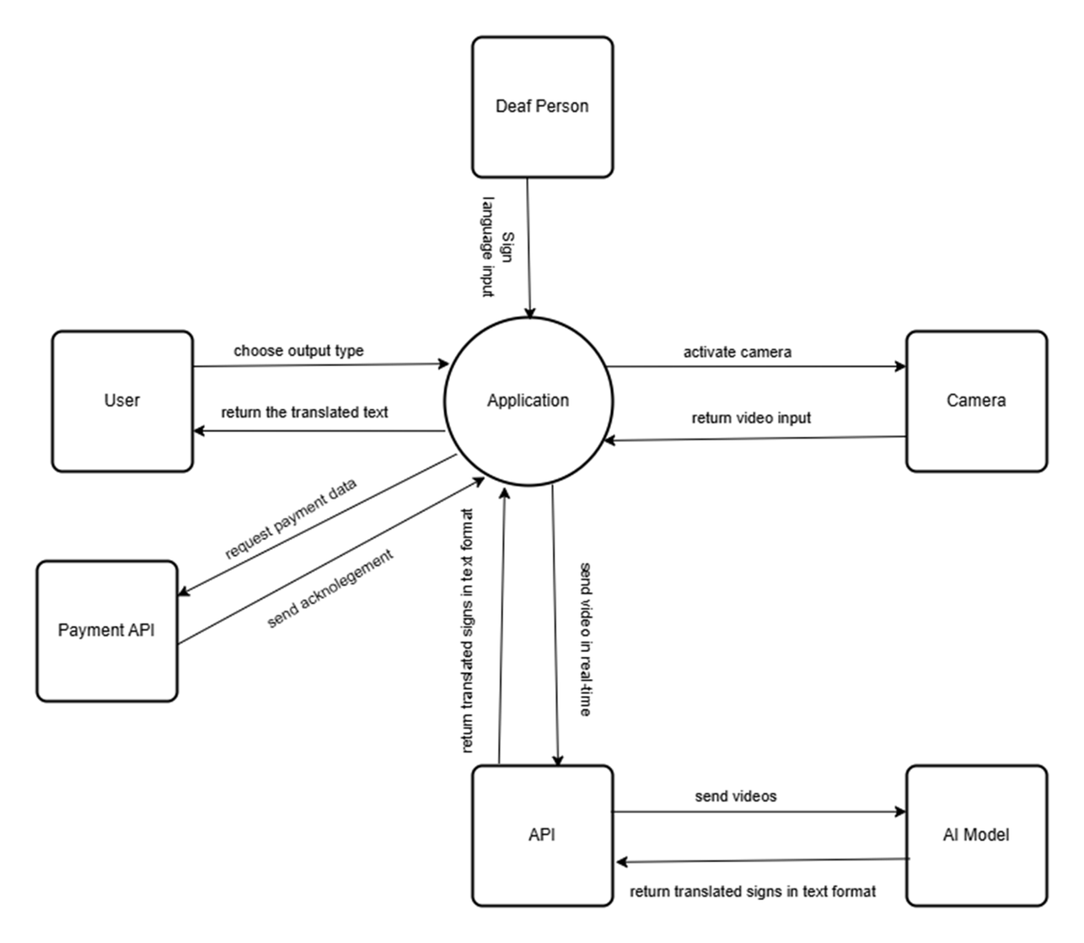

Slide 29
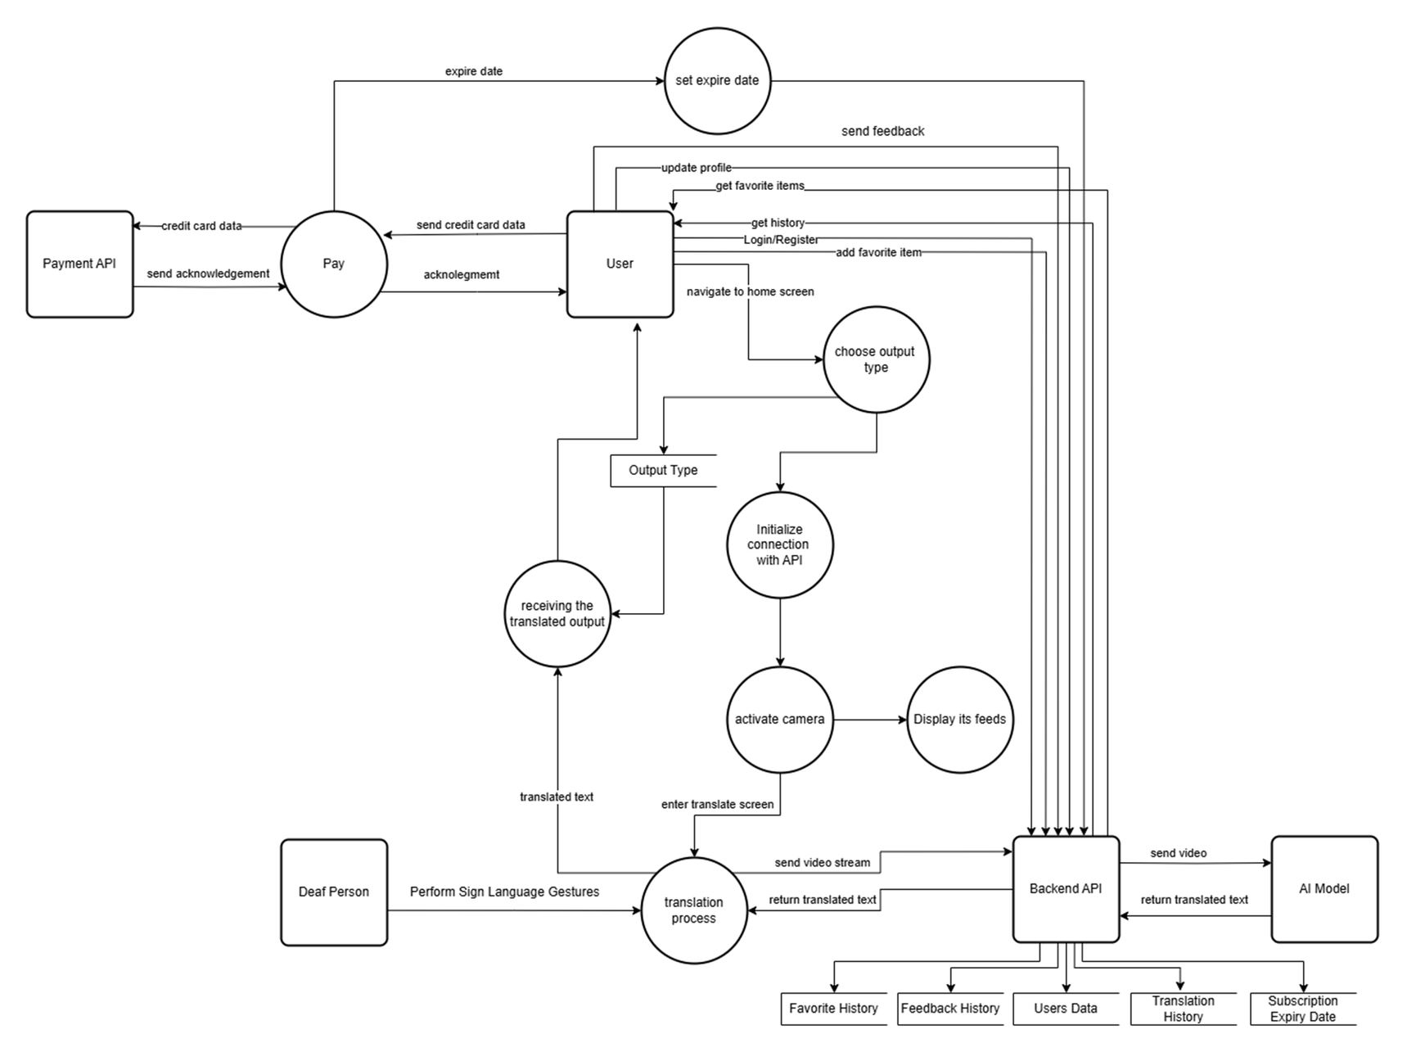

Slide 30
USE CASE DIAGRAM
System actors: users, administrators, API, AI model
Deaf User
Speaking User
Adminstrator
Capture sign language
View translated text
Use offline mode
Input spoken text
View translated sign language
Use split-screen
Manage user accounts
Configure app settings
Monitor system performance

Slide 31
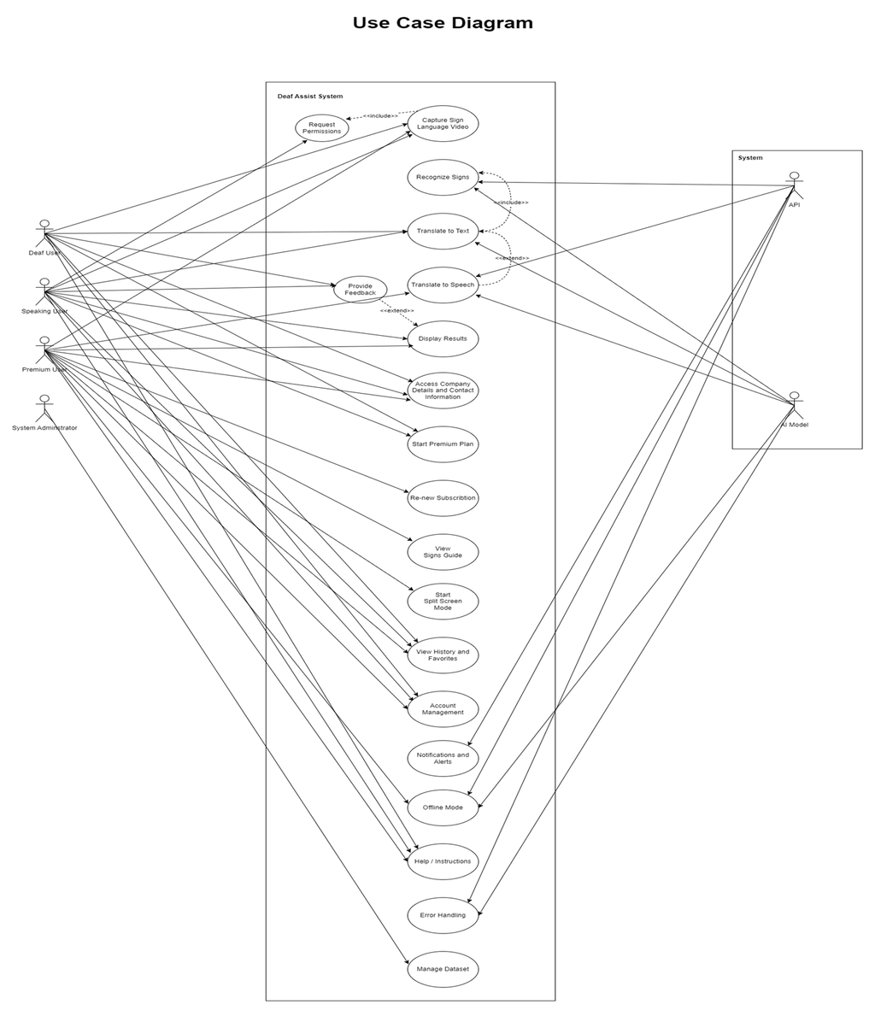

Slide 32
CLASS DIAGRAM
01: KEY CLASSES
02: Relationships
User, Translation, AI Model, Notification, Feedback, Premium features
User interacts with Translation Process and Preferences

Slide 33
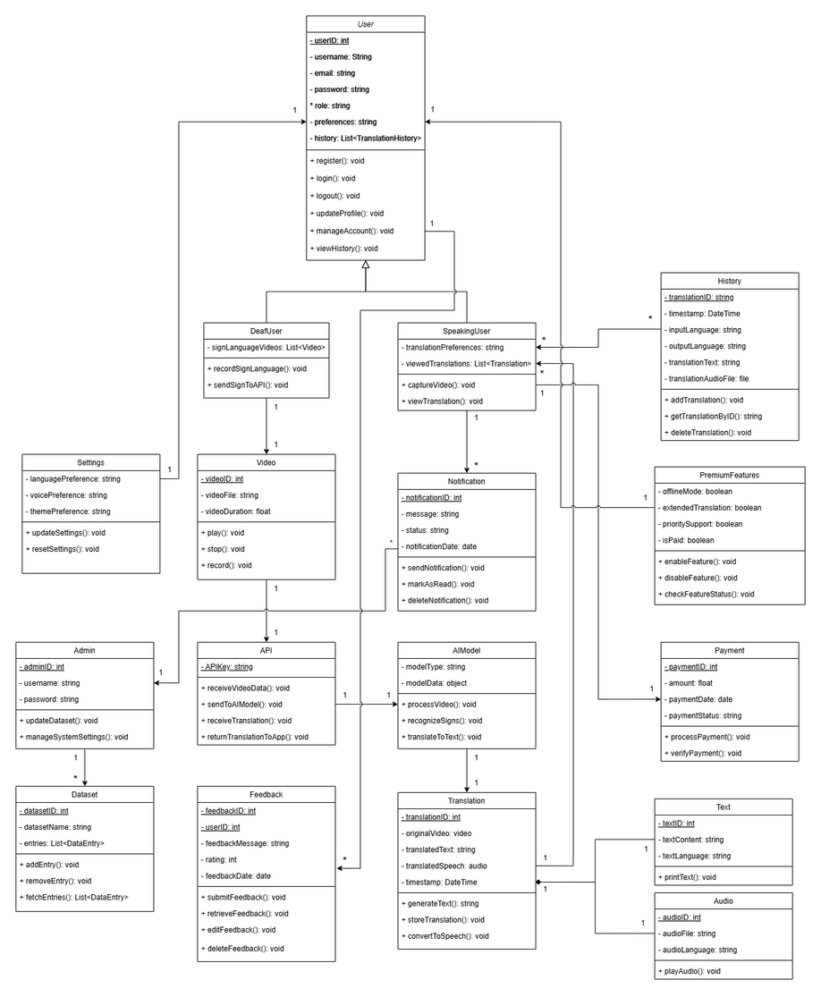

Slide 34
ACTIVITY DIAGRAM
Illustrates user journey from login to accessing app features, including all user access variation.

Slide 35
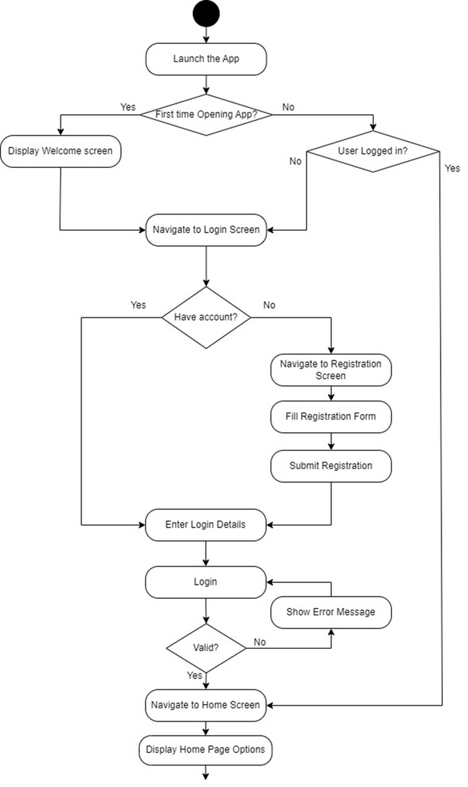

Slide 36
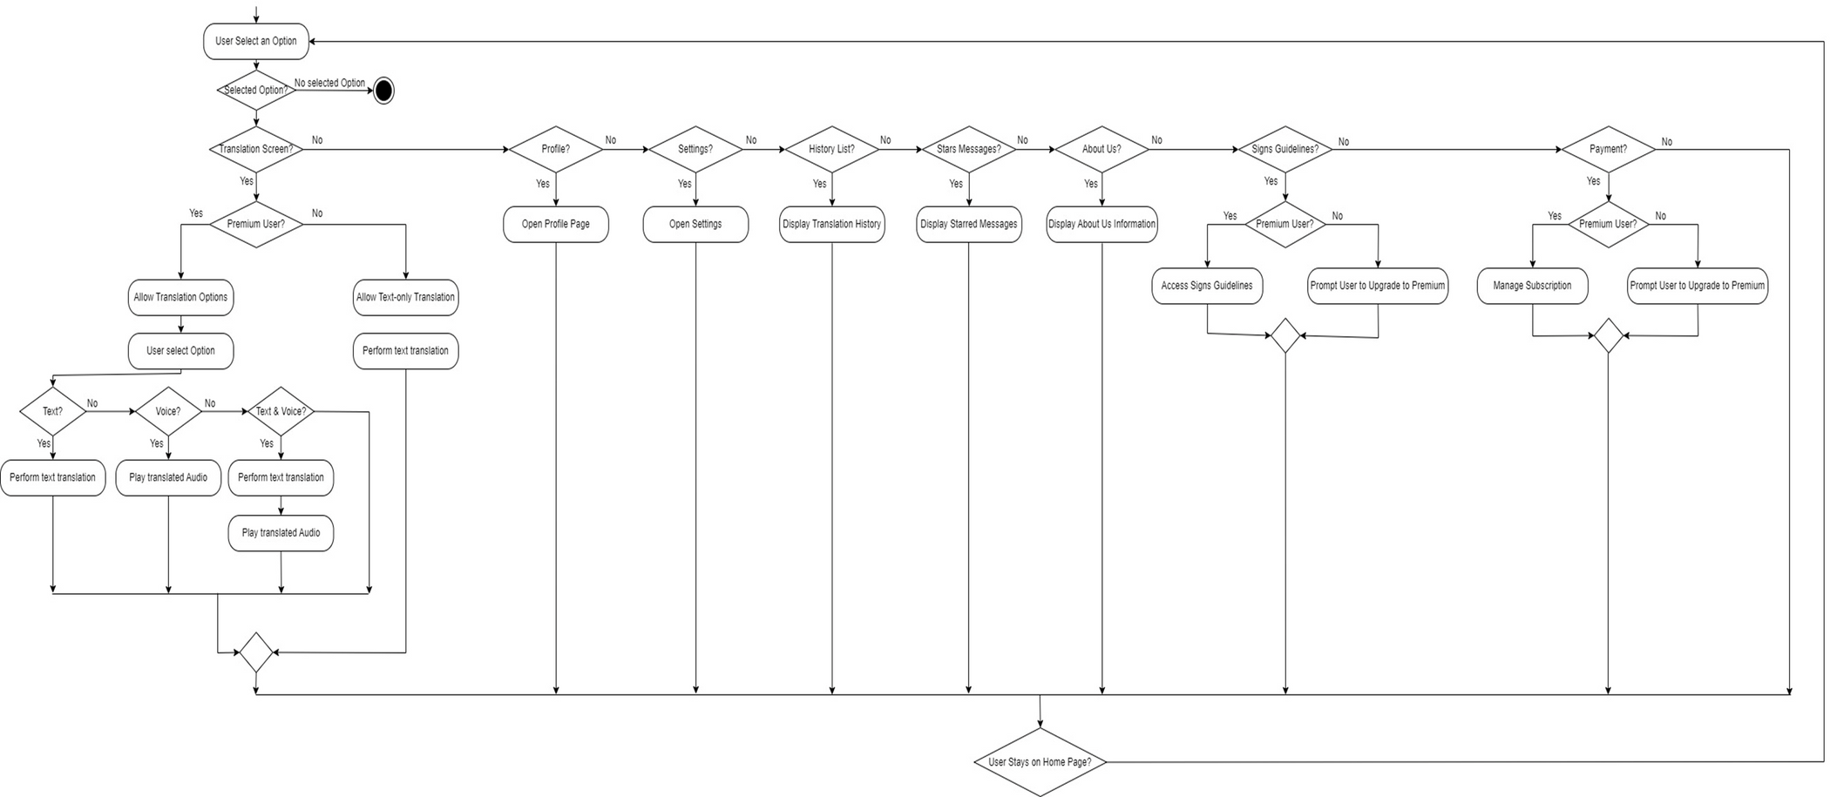

Slide 37
SEQUENCE DIAGRAM
AI Model analyzes video, generating translation.
User records a video using the app.
App displays translated text.
User Captures Video
AI Model Processes
User Receives Output
API Returns Translation
App Sends to API
App transmits video to translation API.
API sends translated text or speech to app.

Slide 38
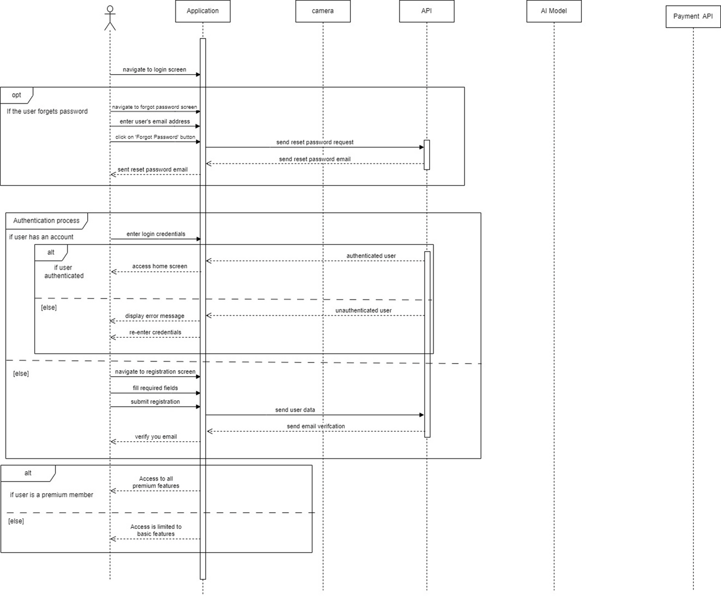

Slide 39
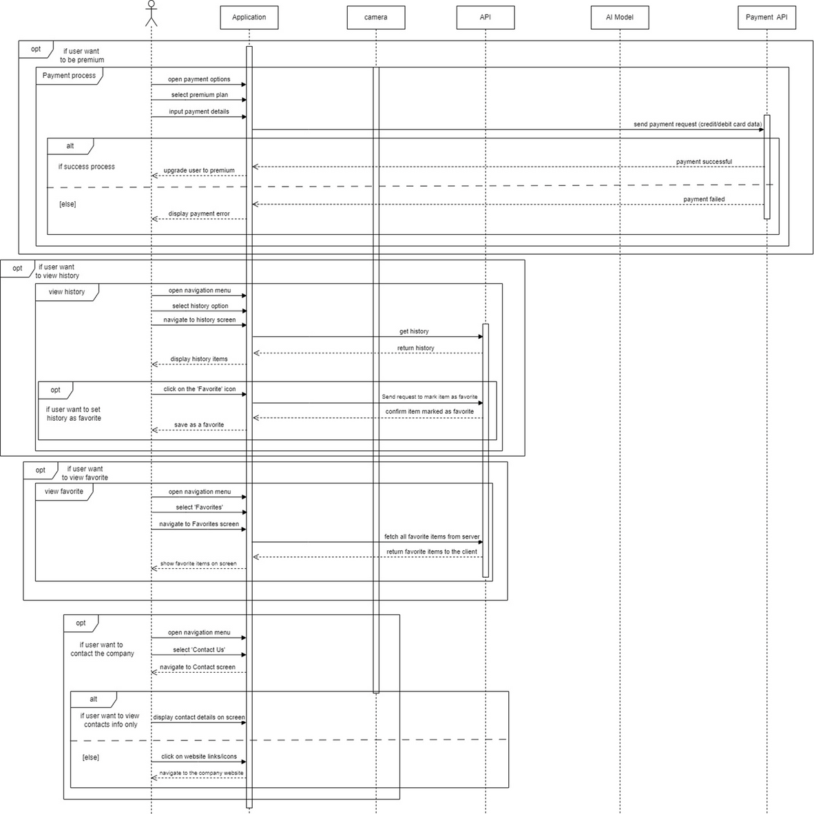

Slide 40
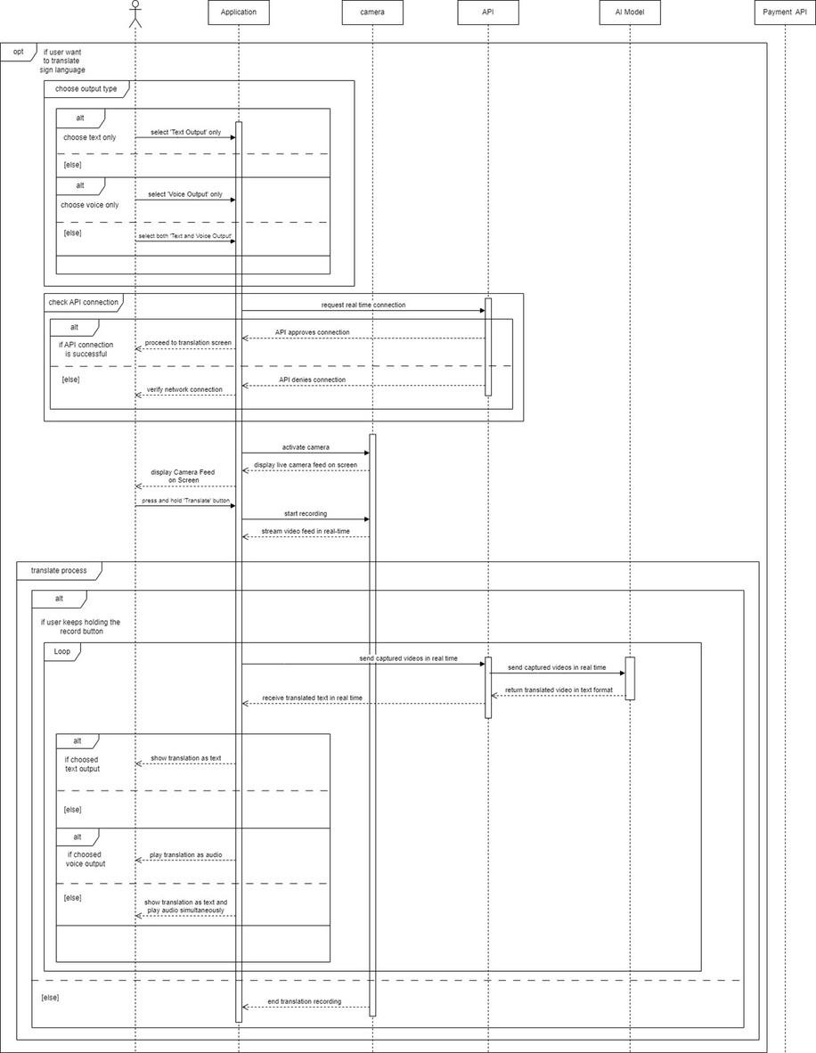

Slide 41
ENHANCED ENTITY-RELATIONSHIP DIAGRAM
Defines The Database Structure For The App.
01: Entities
02: Relationships
User, Translation, Video, Text, Features, Feedback.
E.g., User generates Translation; Translation includes Video and Text.

Slide 42
